Slide 1

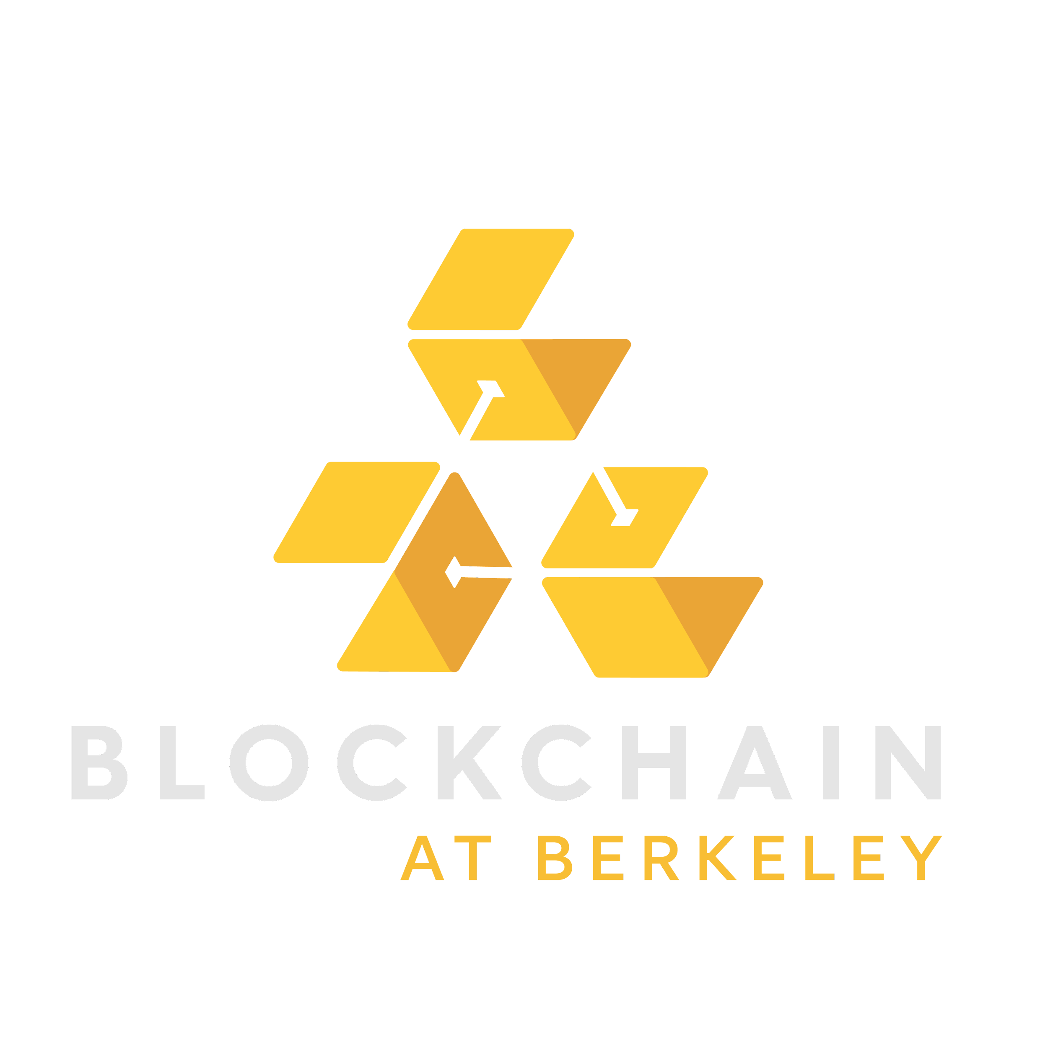
BLOCKCHAIN:
Özal YILDIRIM

Slide 2
GENEL BAKIŞ
1
BITCOIN NEDIR?
2
KIMLIK
3
ALIM SATIM İŞLEMLERİ
4
KAYIT TUTMA
(Blokzincir)
5
KONSENSUS (PROOF-OF-WORK)
BLOCKCHAIN FUNDAMENTALS LECTURE 1
Notes:
Today we’re going to be learning things from the perspective of the most famous application of blockchain technology - can anyone guess what that is?
Analyzing stuff from the bitcoin perspective helps us understand what why and how properly

Slide 3
1
WHAT IS BITCOIN?
BLOCKCHAIN FUNDAMENTALS LECTURE 1

Slide 4

Anonim (Anonymous)
Merkeziyetsiz
(Decentralized)
Değiştiremeyen
(Immutable)
Güvenilir değil!
(Trustless)
Consensus
Global
Notes:
Bitcoin has no central bank, no central entity controlling its supply or properties. It does many things that a bank does, but more, since it’s a bank that’s open to the whole world.
Bitcoin has no central registry of identities, allowing anyone to join with an pseudonym
Similar to social media accounts like Reddit -- everyone’s a username but can choose not to reveal their real world identity
Bitcoin has no central log of information, no one person telling the world who owns what amount of bitcoins.
This Bitcoin ledger is kept among thousands of people involved in the Bitcoin network.
You don’t have to know your peers in Bitcoin to trust the math and economics behind it.
Bitcoin is trustless, with a protocol that allows you to distinguish malicious peers from honest ones.
There’s no central point of failure, no one can individually alter the Bitcoin database.
This makes it immutable, as thousands of peers exist. It’s as if someone took a bank’s records and shared them with the world, now there’s no way to change the records without changing thousands simultaneously.
Bitcoin comes to “consensus” on who owns what through a consensus algorithm
Allows you to agree with people you don’t know and don’t trust on some mutually respected history of events
As a consequence of all these things, Bitcoin is global
Anyone from anywhere around the world can join this global infrastructure, since everything’s online and represented as software.

Slide 5

CLARITY
TESTING UNDERSTANDING
BLOCKCHAIN
BITCOIN
CRYPTO
AUTHOR: OMKAR SHANBHAG
Notes:
Let’s start the day with some mental organization
Ask if anyone can explain difference
What does crypto mean????

Slide 6
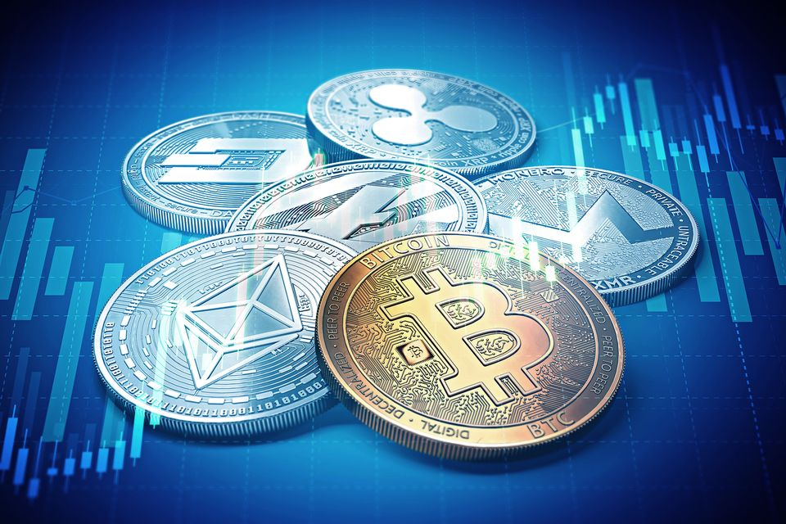
DEFINITIONS
QUICK REVIEW
Kripto para birimi (cryptocurrency): Bilgisayar bilimi, kriptografi ve ekonomi kullanılarak birbirine bağlanan tamamen dijital para birimi.
Bitcoin bir kripto para birimidir
Blockchain: Kripto para biriminin arkasındaki veri yapısı. Güven gerektirmeden veri bütünlüğünü sağlayan birden çok taraf arasında veri depolama yöntemi.
source: https://yle.fi/uutiset/osasto/news/finance_ministry_crackdown_on_cryptocurrency_trade/10040789
AUTHOR: TIM HUANG
Notes:
First, let’s review some fundamental blockchain concepts by looking at some definitions. A cryptocurrency is a completely digital, formless currency that is tied together using computer science, and cryptography, and economics. A cryptocurrency uses computer science for efficiency, cryptography for security, and economics for incentive alignment.
Blockchain is the data structure behind cryptocurrency. It is method of storing data among more than one party that ensures data integrity without requiring trust.

Slide 7
WHAT IS BLOCKCHAIN?
BITCOIN’S GENESIS
...
Blockchain: veri bütünlüğünü sağlayan birden çok taraf arasında veri depolama yöntemi
Birisi "blockchain" dediğinde, genellikle şunu kasteder:
Değişmezliği ve şeffaflığı nedeniyle dikkat çeken kripto para birimlerinin arkasındaki teknoloji
Blockchain'e işlenen veriler değiştirilemez
"Dağıtık bir kayıt defteri (distributed ledger)" veya herkesin bir kopyasını elinde bulundurduğu paylaşılan bir veritabanı
...
...
...
AUTHOR: ZHAO
BLOCKCHAIN FUNDAMENTALS LECTURE 1
Notes:
Cool so now we know what a blockchain is we can all go home, decal finished,
Purpose of saying that was to highlight the fact that throughout this course we’ll be grappling with a lot of why’s whats and how’s
Important quick side note: When it comes to learning blockchain, there will always be the distinction between what and how? So for example blockchain is decentralized that is the what, and like proof of work which is used to facilitate decentralization that is the how. Chains of what and how → blockchain is peer to peer (what) ---> Decentralized (how) , Decentralized (what) → Consensus mechanisms (how). Its like a little kid asking questions → why do you go to work to make money to be happy etc. ---> What is blockchain? ---> peer to peer network, how? → decentralization, how? → proof of work?
Back in the Bitcoin is the first decentralized, anonymous, immutable, and global currency. Anyone from anywhere around the world with an internet connection and software can be a part of Bitcoin’s network.
In the 1980s and 90s, the Cypherpunk movement evolved out of libertarian ideologies of independence from a central point of control, most frequently the government. As technology for surveillance and information collection grew in strength, most of the public, albeit complacent, feared for their privacy and independence. Cypherpunks, however, refused to sit back and let Big Brother run them over. Instead, they fought technology with technology: they looked to cryptography to protect their identities and messages.

Slide 8
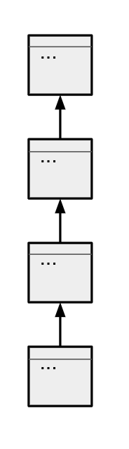
TANIMLAR
Blockchain'in Temel Özellikleri:
Merkezi olmayan (Decentralized): merkezi otorite yok, merkezi başarısızlık noktası yok. Dağıtık veritabanı.
Dağıtık defter (Distributed ledger): defterdeki herkesin bir kopyaya sahip olduğu paylaşılan veritabanı
Konsensüs: Proof of Stake, Proof of Work, vb.
Değişmez (Immutable): Kriptografik hash işlevleriyle güvence altına alınır. Blok zincirine işlenen veriler değiştirilemez.
AUTHOR: TIM HUANG
Notes:
Next, let’s look at some key components to how blockchain functions. First, the blockchain must be immutable. The blockchain stores data in chronological chunks, and secures each chunk with cryptographic hash functions that render the committed data immutable. This means that data committed to the blockchain cannot be changed.
Second, the blockchain is a distributed ledger, which means everyone in the network holds a copy.
Third, the blockchain is decentralized, which means that there is no central authority that determines the data on the blockchain, and no central point of failure
Fourth, the blockchain must achieve consensus. The blockchain must update itself and ensure that everyone on the network receives the same updates to the blockchain. The blockchain must achieve consensus between different nodes to agree on how the blockchain should be updated. Some commonly used consensus algorithms are proof of work and proof of stake.
Next, let’s look at some key components to how blockchain functions. First, the blockchain must be immutable. The blockchain stores data in chronological chunks, and secures each chunk with cryptographic hash functions that render the committed data immutable. This means that data committed to the blockchain cannot be changed.
Second, the blockchain is a distributed ledger, which means everyone in the network holds a copy.
Third, the blockchain is decentralized, which means that there is no central authority that determines the data on the blockchain, and no central point of failure
Fourth, the blockchain must achieve consensus. The blockchain must update itself and ensure that everyone on the network receives the same updates to the blockchain. The blockchain must achieve consensus between different nodes to agree on how the blockchain should be updated. Some commonly used consensus algorithms are proof of work and proof of stake.

Slide 9
Blok zinciri, depolama konumunun, verinin büyüyüp değişme biçiminin ve veri üzerinde kimin kontrole sahip olduğunun çoğu geleneksel sistemden farklı olduğu veri depolama yöntemidir.
Nasıl farklı?
Merkeziyetsiz!!

Slide 10
What is Decentralization?
AUTHOR: TIM HUANG
Notes:
Next, let’s look at some key components to how blockchain functions. First, the blockchain must be immutable. The blockchain stores data in chronological chunks, and secures each chunk with cryptographic hash functions that render the committed data immutable. This means that data committed to the blockchain cannot be changed.
Second, the blockchain is a distributed ledger, which means everyone in the network holds a copy.
Third, the blockchain is decentralized, which means that there is no central authority that determines the data on the blockchain, and no central point of failure
Fourth, the blockchain must achieve consensus. The blockchain must update itself and ensure that everyone on the network receives the same updates to the blockchain. The blockchain must achieve consensus between different nodes to agree on how the blockchain should be updated. Some commonly used consensus algorithms are proof of work and proof of stake.

Slide 11
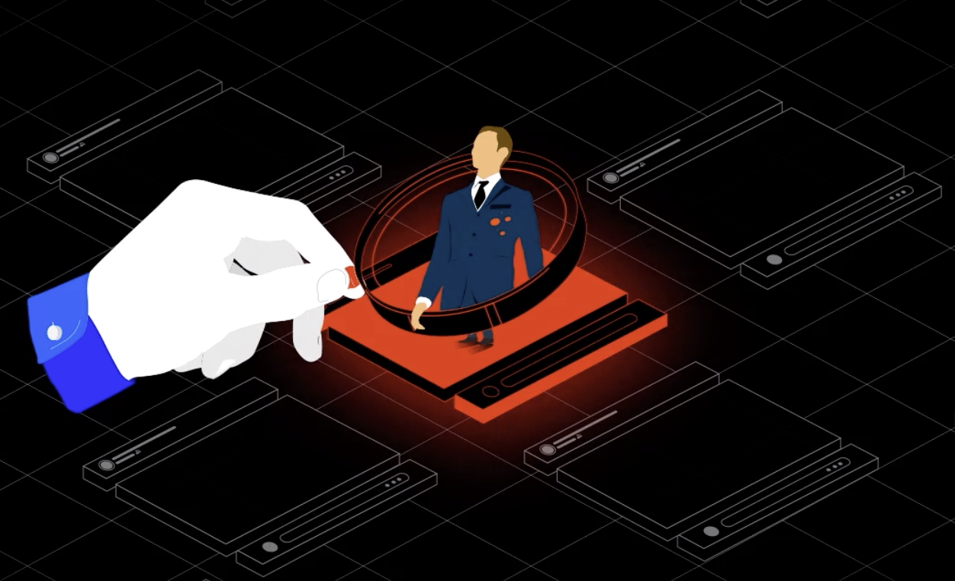
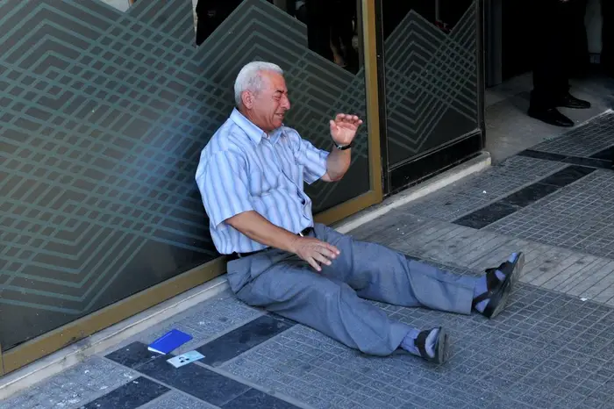
WHAT IS CENTRALIZATION?
Merkezi otorite
Yetkilendirme/Doğrulama (Authorization/Verification), bir varlık tarafından yönetilen sistemin durumu
Sıkıdenetim
Arızanın Merkezi Noktası
Source
Source
Notes:
In order to understand what decentralization is we need to first understand centralization and problems with it.
Centralization is a system where there all decisions regarding authorization and what the state of the system is, as well as all storage of data and assets are managed by a single, central authority.
This allows for Censorship, as well as a central point of failure.
Ok so what does this mean, I just said a lot of things about centralizations. Let’s take a look at an example from the financial world since we’re going to be looking at bitcoin today.
Look at the way credit card companies or banks operate.
All data is controlled by single entity. That is visa or Bofa or whatever.
During normal transactions usually a bank or credit card company will be the one authorizing it. And the state of the system is also managed by the bank.
What does state of the system mean? In financial systems this usually refers to how much money each person has. Say for example you have a bank with 3 accounts, it can be in many different states A can have 100 B can have 200 C can have 300 ---> or A can have …..
The state that the system is in is managed by the bank.
Now i also mentioned censorship, and a central point of failure
Censorship → talk about facebook a centralized application, having complete control over what goes on in the network → censoring conservative media like in the first picture
Central point of failure → Many bank hacks for example Capital One hack where millions of users data got compromised, including many social security numbers
Talk about the picture of them greek man → Greek debt crisis → Banks had to close up and didn’t let people collect money that they needed that was rightfully theirs
Any questions about centralization?

Slide 12
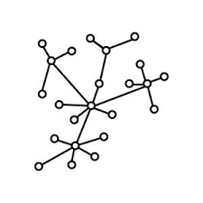

WHAT IS DECENTRALIZATION?
EXAMPLES
Veri depolama, doğrulama, sistemin durumuyla ilgili kararların herkese devredilmesini ve dağıtılmasını içerir.
Nasıl?
Consensus Mekanizması (Topluluk temelli)
Dağıtık kayıt cüzdanı
Değiştirilemez
Eşler arası ağ (Eşitlik)
Sade bir demokrasi
Notes:
Ok now that we have a stronger understanding of what centralization is, lets look at decentralization.
Decentralization involves the delegation and distribution of data storage, verification, decisions on state of system to everyone.
What does this mean? It means that there is no longer one central entity that has control over what transactions are good and what transactions aren’t good and no central authority decides what the state of the system is.
This means that we have to figure out a way for all node to come to consensus → we will go through this in more detail later in this lecture and throughout the course, so for now just understand that in order for stuff to be decentralized, people need to come to a consensus.

Slide 13
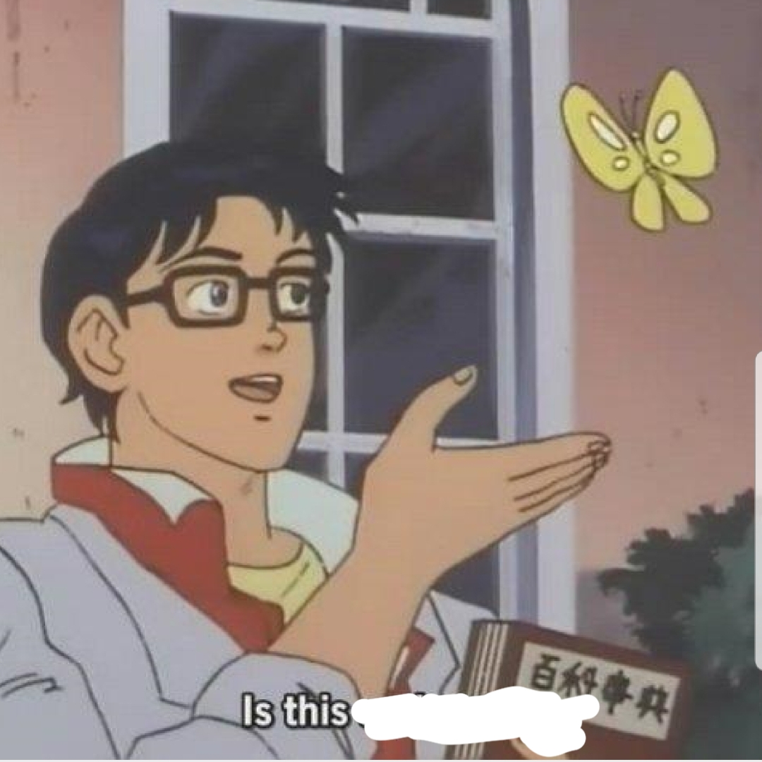

WHAT IS BITCOIN?
BITCOIN’S GENESIS
Bitcoin, 2008 yılında Satoshi Nakamoto tarafından oluşturulan bir kripto para birimidir.
Cryptocurrency: “bilgisayar bilimi, kriptografi ve ekonomi üzerine kurulu bir para birimi”
Neden önemli: tamamen dijital ve herhangi bir merkezi kuruluş tarafından kontrol edilmiyor
İdeoloji, kriptografi kullanarak gizlilik ve kendi kendini yönetme için özgürlükçü bir mücadele olan Cypherpunk hareketinden kaynaklanır.
Blockchain olarak bilinen veri yapısının orijinal kullanımı
a peer-to-peer cash system?
AUTHOR: NADIR AKHTAR & GLORIA ZHAO
BLOCKCHAIN FUNDAMENTALS LECTURE 1
Notes:
Back in the Bitcoin is the first decentralized, anonymous, immutable, and global currency. Anyone from anywhere around the world with an internet connection and software can be a part of Bitcoin’s network.
Venmo: what if this, what if that. We don’t have the guarantee and safety of my money.
Nadir has more details
In the 1980s and 90s, the Cypherpunk movement evolved out of libertarian ideologies of independence from a central point of control, most frequently the government. As technology for surveillance and information collection grew in strength, most of the public, albeit complacent, feared for their privacy and independence. Cypherpunks, however, refused to sit back and let Big Brother run them over. Instead, they fought technology with technology: they looked to cryptography to protect their identities and messages.

Slide 14
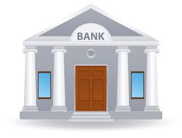
BANKALAR
Kimlik yönetimi
(Identity Management)
Kişisel bilgileriniz ve hesap bakiyeleriniz için depolama
İşlemler (Transactions)
Para Transferi ve Para Çekme
Kayıt yönetimi
Özellikle denetimler için hesap geçmişini izleme
Güven
Devlet tarafından doğrulanmış yetkililer
Bir bankanın yaptığı her şeyi yapan merkezi olmayan bir sistemi nasıl yaparız?
AUTHOR: NADIR AKHTAR & GLORIA ZHAO
BLOCKCHAIN FUNDAMENTALS LECTURE 1

Slide 15

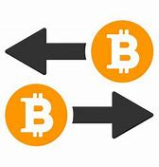
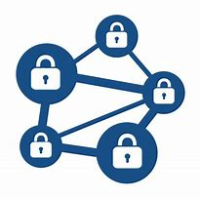

CURRENCY
BITCOIN COMPONENTS
Kimlik yönetimi
Bitcoine sahip, gönderebilen ve alabilen adresler/hesaplar
İşlemler
Güvenli bitcoin gönderme ve alma yeteneği
Distributed Ledger
Ağ genelinde bitcoin transferlerinin kayıtları
Güvensiz Konsensüs
Topluluk hedeflerinin kişisel teşviklerle uyumlu hale getirilmesi
AUTHOR: NADIR AKHTAR & GLORIA ZHAO
BLOCKCHAIN FUNDAMENTALS LECTURE 1

Slide 16
2
IDENTITY
(KİMLİK)
BLOCKCHAIN FUNDAMENTALS LECTURE 1

Slide 17
IDENTITY
IDENTITY IN BITCOIN
“Para birimleri bağlamında kimliğin rolü nedir?”
AUTHOR: NADIR AKHTAR
BLOCKCHAIN FUNDAMENTALS LECTURE 1
Notes:
Authentication vs Blaming
Can’t undo signature (non-repudiable)
Can’t retrieve private key once lost
Integrity: Can be sure that no one can intercept and modify, tamper-evident
Authentication: “You don’t want anyone else receiving, claiming, or spending your money. For your protection, currencies require authentication to ensure that you and you alone have control of your assets.”

Slide 18
IDENTITY
IDENTITY IN BITCOIN
Para birimleri bağlamında kimliğin rolü nedir?
para almak
Para talep etmek/harcamak
Suçlamak
Günlük yaşamda kimlik:
E-postaların adları ve şifreleri vardır
Bitcoin'in genel anahtarları (public key) ve
özel anahtarları (private key) vardır
AUTHOR: NADIR AKHTAR
BLOCKCHAIN FUNDAMENTALS LECTURE 1
Notes:
Authentication vs Blaming
Can’t undo signature (non-repudiable)
Can’t retrieve private key once lost
Integrity: Can be sure that no one can intercept and modify, tamper-evident
Authentication: “You don’t want anyone else receiving, claiming, or spending your money. For your protection, currencies require authentication to ensure that you and you alone have control of your assets.”
Blame: We want to be able to know which account spent how much money - we want to be able to agree on what has happened in the past and be able to prove that a certain account did somethign
Two parts: public facing identity and private information to authenticate

Slide 19
IDENTITY
TRADITIONAL MODEL
Kimlik, kişisel bilgilerle onaylanır
Kimlik numarası
İsim
Doğum günü
Adres
Kullanıcı adı ve şifre merkezi yönetici tarafından verilir
Banka, kullanıcı adlarının benzersiz olmasını sağlar
AUTHOR: GLORIA ZHAO
BLOCKCHAIN FUNDAMENTALS LECTURE 1
Notes:
So how does it work with identity in current financial systems? You go to the bank and you basically confirm your account using your personal information like your SSN Name, BDay address etc.
And then the bank basically makes sure that usernames are unique, this management happens in a centralized manner

Slide 20
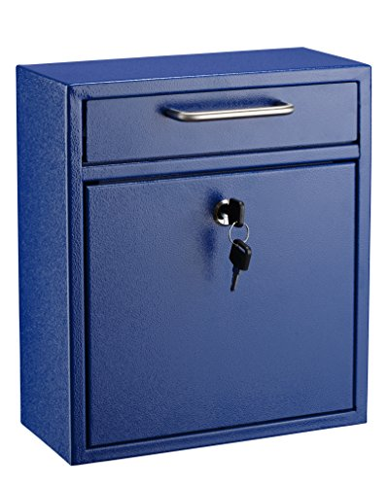
IDENTITY
PUBLIC AND PRIVATE KEYS
Her varlık benzersiz bir ortak anahtarla temsil edilir
Karşılık gelen bir özel anahtar (private key), genel anahtarın (public key) ve paranızın "kilidini açmak" için bir anahtar görevi görür.
Rastgele seçilen özel anahtar, özel anahtardan oluşturulan genel anahtar
Almak için genel anahtar, kullanmak için özel anahtar
Image source: https://images-na.ssl-images-amazon.com/images/I/51rh0s9VdyL.jpg
AUTHOR: NADIR AKHTAR
BLOCKCHAIN FUNDAMENTALS LECTURE 1
Notes:
Private key chosen at random, public key generated from private key: “It’s as if you drew a random, scrambled key on a giant piece of paper and someone made a custom lock and physical key based on that drawing”
“Hard to replicate, even by mistake -- even small differences in the ‘drawing’ change the shape of the lock”
This has to do with cryptographic hash functions
Public key for receiving, private key for redeeming: “Email aliases are designed to be shared, but passwords aren’t. You’re safe giving people access to your protected figurative chest of bitcoins as long as you don’t give them the key to get inside.”

Slide 21
IDENTITY
PUBLIC AND PRIVATE KEYS
Kişisel bilgi gerekmez
Bu, Bitcoin'in anonim olduğu anlamına mı geliyor?
Oluşturabileceğiniz hesapların sınırı yok
Bu Bitcoin'in güvenliğini etkiler mi?
"Alınan" anahtarlarda kısıtlama yok
Bu, birinin benimle aynı özel anahtara sahip olabileceği anlamına mı geliyor?
AUTHOR: GLORIA ZHAO
BLOCKCHAIN FUNDAMENTALS LECTURE 1
Notes:
Private key chosen at random, public key generated from private key: “It’s as if you drew a random, scrambled key on a giant piece of paper and someone made a custom lock and physical key based on that drawing”
“Hard to replicate, even by mistake -- even small differences in the ‘drawing’ change the shape of the lock”
Public key for receiving, private key for redeeming: “Email aliases are designed to be shared, but passwords aren’t. You’re safe giving people access to your protected figurative chest of bitcoins as long as you don’t give them the key to get inside.”

Slide 22
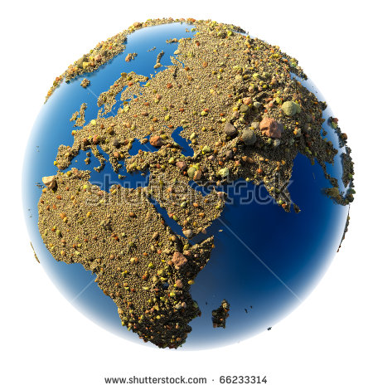
IDENTITY
PUBLIC KEY GÜVENLİĞİ
"Ya biri benim özel anahtarımı tahmin ederse?!"
https://www.shutterstock.com/image-illustration/sandy-planet-earth-sand-gravel-pebbles-66233314
AUTHOR: NADIR AKHTAR
BLOCKCHAIN FUNDAMENTALS LECTURE 1
Notes:
(Make black)

Slide 23
IDENTITY
PUBLIC KEY SECURITY
https://www.shutterstock.com/image-illustration/sandy-planet-earth-sand-gravel-pebbles-66233314
AUTHOR: NADIR AKHTAR
BLOCKCHAIN FUNDAMENTALS LECTURE 1
Notes:
(Make black)

Slide 24
IDENTITY
SECURITY: HIDDEN IN PLAIN SIGHT
Bitcoin
2¹⁶⁰ (1,461,501,637,330,902,918,203,684,832,716,283,019,655,932,542,97) olası adrese sahiptir.
Rastgele ortak anahtar oluşturma kullanarak herhangi birinin çakışması neredeyse imkansız
Nisan 2017 Dünya nüfusu: 7.5 milyar
Herkes kendisine yaklaşık 2¹²⁶ adres seçebilir.
AUTHOR: MAX FANG
UPDATED BY NADIR AKHTAR
BLOCKCHAIN FUNDAMENTALS LECTURE 1
Notes:
(Make black)

Slide 25
3
TRANSACTIONS
(İŞLEMLER)
BLOCKCHAIN FUNDAMENTALS LECTURE 1

Slide 26
TRANSACTIONS
VALIDITY
"Bir işlemi geçerli kılan nedir?"
AUTHOR: NADIR AKHTAR
BLOCKCHAIN FUNDAMENTALS LECTURE 1
Notes:
Discussion: get some answers called out
Medium of transaction must be valid/have value
Good storage of value over time, stable medium of exchange (don’t want the price to inflate/deflate quickly in a short amount)
Identify who is giving, who is receiving
Need to be trustworthy: make sure that no one is using funds 2 times, no one can pay someone else and still keep the same amount of funds

Slide 27
TRANSACTIONS
VALIDITY
Mülkiyet kanıtı (imza)
Kullanılabilir fonlar
Aynı fonları kullanan başka işlem yok
AUTHOR: NADIR AKHTAR
BLOCKCHAIN FUNDAMENTALS LECTURE 1
Notes:
Easy to identify first bullet -- just need private key
For second and third bullet, intuitive to keep track of with accounts but actually reasonably difficult memory-wise and security-wise
Easier to merely keep track of transaction inputs and outputs without summing up into an account

Slide 28
TRANSACTIONS
TRADITIONAL MODEL
Merkez yöneticisi hesap bakiyelerini takip eder ve işlemlerin geçerli olduğunu doğrular
Her hesabın kullanılabilir bir bakiyesi vardır
Harcanan miktar toplam paradan çıkarılır.
Alınan için para toplamına eklenir
Gloria
Balance: $100.00
-10.00
Brian
Balance: $250.00
+10.00
AUTHOR: GLORIA ZHAO
BLOCKCHAIN FUNDAMENTALS LECTURE 1
Notes:
Authentication vs Blaming
Can’t undo signature (non-repudiable)
Can’t retrieve private key once lost
Integrity: Can be sure that no one can intercept and modify, tamper-evident
Authentication: “You don’t want anyone else receiving, claiming, or spending your money. For your protection, currencies require authentication to ensure that you and you alone have control of your assets.”

Slide 29
4
RECORD-KEEPING
(KAYIT TUTMA): THE BLOCKCHAIN
BLOCKCHAIN FUNDAMENTALS LECTURE 1

Slide 30
RECORD-KEEPING
TRADITIONAL MODEL
Merkezi Veritabanı tüm verileri saklar
Central Manager, verileri düzenleyerek günceller
Bilgisayar korsanlarını ve başarısızlığı önlemek için güvenlik önlemleri
AUTHOR: GLORIA ZHAO
BLOCKCHAIN FUNDAMENTALS LECTURE 1
Notes:
In a bank, there is some kind of central database that has security measures to keep hackers from changing things. There might be multiple copies in case their server goes down, but what we know is that the bank alone holds our data. If we disagree with the data we see, we have to take it up with the bank because their record is THE record.

Slide 31
RECORD-KEEPING
DISTRIBUTED DATABASES
Sender | Recipient | Amount (BTC)
Justin | Oscar | 4
Justin | Justin | 1
Oscar | Rustie | 5
Oscar | Oscar | 1
Janice
Rustie
Tüm bu işlemleri nasıl saklıyoruz?
⇒ distributed database
(dağıtık veritabanı)
Satoshi
?
Justin
Oscar
AUTHOR: NADIR AKHTAR
BLOCKCHAIN FUNDAMENTALS LECTURE 1
Notes:
Okay, so say that we have a network of five people that are sending and receiving transactions from one another. Up on the upper right corner, we have a table representing the transactions that have occurred at some point in time. We don’t want to store these transactions in a centralized database because that’s not what this course is about, so what do we do? Put it in a distributed database, such as a blockchain. We want to be able to store this entire table in a singular block on the blockchain, and verify it somehow so that future transactions may be verified as well in a future block.
But we don’t want just one person to keep track of transactions, right? But who’s going to keep track of all the transactions that happened in the past? We also don’t want just a couple people in the network with access to this information, because that’s still somewhat centralized, as you’re trusting these few individuals with this history. So what do we do? Let everyone have a copy!

Slide 32
RECORD-KEEPING
EVERYONE’S THE BANK
Janice
Rustie
İşlemleri bloklar halinde derler ve bir blok zincirinde saklarız.
İsteyen Herkeste blok zincirinin bir kopyası vardır
Satoshi
Justin
Oscar
AUTHOR: NADIR AKHTAR
BLOCKCHAIN FUNDAMENTALS LECTURE 1
Notes:
To get as far as possible from having a central entity, we want everyone in a distributed system to be equally powerful - every person’s claim to the transaction history is equally legitimate, and there is no one person to bribe or hack to alter the database. That’s what we mean by no central point of failure.
We also don’t store every single transaction individually because that means every time a transaction is made, everyone’s database has to be updated at the same time. But it takes time for the information of a transaction to propagate throughout the system, b/c latency and other various factors, so we store the aggregate outcome of various transactions in a single block.

Slide 33


TRANSACTIONS
UTXO MODEL
Blockchain harcanmamış parayı takip eder
Her hesapta bir dizi Harcanmamış İşlem Çıktısı-Unspent Transaction Outputs - (UTXO) bulunur: bu hesaba gönderilen ve henüz kullanılmamış bitcoin miktarları
Bir UTXO, herhangi bir miktarda bitcoin içerebilir ve tamamı harcanır.
UTXO'lar yalnızca bir kez kullanılabilir
Justin
Oscar
Justin’s 5 BTC
Justin’s 1 BTC
Justin’s 2 BTC
Justin’s 0.1 BTC
Oscar’s 2 BTC
Oscar’s
1.5 BTC
Oscar’s 10 BTC
AUTHOR: GLORIA ZHAO
BLOCKCHAIN FUNDAMENTALS LECTURE 1
Notes:
Bitcoin handles this in a black and white way that’s easy for a computer to understand.
(Make black)
Piggy bank analogy
A new piggy bank is constructed for every new received transaction
To make a new transaction, you break open a piggy bank and use however much
Explicitly mention change address
Benefits???:
Parallelization: Can spend in multiple txs w/o worrying about account balance
more here: https://ethereum.stackexchange.com/questions/326/what-are-the-pros-and-cons-of-ethereum-balances-vs-utxos
Instead of keeping all your cash in one chest, each received payment goes into a new piggy bank
Every time you need to make a transaction, you break one or more piggy banks
All bitcoins have a “serial number,” the reference number when using UTXOs as inputs for other transactions
Note: Satoshi is the smallest unit of a bitcoin (10^-8)

Slide 34
TRANSACTIONS
UTXO MODEL
Justin
Oscar
Rustie
Justin’s 5 BTC
Justin’s
1 BTC
Justin’s 2 BTC
Oscar’s 2 BTC
Rustie’s 5 BTC
Rustie’s 1 BTC
AUTHOR: GLORIA ZHAO
BLOCKCHAIN FUNDAMENTALS LECTURE 1
Notes:
(Make black)
Piggy bank analogy
A new piggy bank is constructed for every new received transaction
To make a new transaction, you break open a piggy bank and use however much
Explicitly mention change address
Benefits???:
Parallelization: Can spend in multiple txs w/o worrying about account balance
more here: https://ethereum.stackexchange.com/questions/326/what-are-the-pros-and-cons-of-ethereum-balances-vs-utxos
Instead of keeping all your cash in one chest, each received payment goes into a new piggy bank
Every time you need to make a transaction, you break one or more piggy banks
All bitcoins have a “serial number,” the reference number when using UTXOs as inputs for other transactions
Note: Satoshi is the smallest unit of a bitcoin (10^-8)

Slide 35
TRANSACTIONS
UTXO MODEL
Justin
Oscar
Rustie
Justin’s 5 BTC
Justin’s 1 BTC
Justin’s 2 BTC
Justin’s 1 BTC
Oscar’s 2 BTC
Oscar’s 4 BTC
Rustie’s 5 BTC
Rustie’s 1 BTC
Rustie’s 5 BTC
Justin, Oscar'a şu şekilde 4 BTC göndermek için:
5 BTC içeren UTXO'sunu kullanır
Oscar'a 4 BTC gönderir
Ve kendisine 1 BTC geri gönderir
AUTHOR: GLORIA ZHAO
BLOCKCHAIN FUNDAMENTALS LECTURE 1
Notes:
(Make black)
Piggy bank analogy
A new piggy bank is constructed for every new received transaction
To make a new transaction, you break open a piggy bank and use however much
Explicitly mention change address
Benefits???:
Parallelization: Can spend in multiple txs w/o worrying about account balance
more here: https://ethereum.stackexchange.com/questions/326/what-are-the-pros-and-cons-of-ethereum-balances-vs-utxos
Instead of keeping all your cash in one chest, each received payment goes into a new piggy bank
Every time you need to make a transaction, you break one or more piggy banks
All bitcoins have a “serial number,” the reference number when using UTXOs as inputs for other transactions
Note: Satoshi is the smallest unit of a bitcoin (10^-8)

Slide 36
TRANSACTIONS
UTXO MODEL
Justin
Oscar
Rustie
Justin’s 5 BTC
Justin’s 1 BTC
Justin’s 2 BTC
Justin’s 1 BTC
Oscar’s 2 BTC
Oscar’s 4 BTC
Oscar’s 1 BTC
Rustie’s 5 BTC
Rustie’s 1 BTC
Rustie’s 5 BTC
Oscar Rustie'ye 5 BTC göndermek için
2 BTC ve 4 BTC içeren UTXO'larını kullanır
Rustie'ye 5 BTC Gönderir
Ve kendisine 1 BTC gönderiyor
AUTHOR: GLORIA ZHAO
BLOCKCHAIN FUNDAMENTALS LECTURE 1
Notes:
(Make black)
Piggy bank analogy
A new piggy bank is constructed for every new received transaction
To make a new transaction, you break open a piggy bank and use however much
Explicitly mention change address
Benefits???:
Parallelization: Can spend in multiple txs w/o worrying about account balance
more here: https://ethereum.stackexchange.com/questions/326/what-are-the-pros-and-cons-of-ethereum-balances-vs-utxos
Instead of keeping all your cash in one chest, each received payment goes into a new piggy bank
Every time you need to make a transaction, you break one or more piggy banks
All bitcoins have a “serial number,” the reference number when using UTXOs as inputs for other transactions
Note: Satoshi is the smallest unit of a bitcoin (10^-8)

Slide 37
5
CONSENSUS (PROOF-OF-WORK)
BLOCKCHAIN FUNDAMENTALS LECTURE 1

Slide 38
CONSENSUS
TRADITIONAL MODEL
Nadir
Hepimiz işlemlerimizi, kimsenin çifte harcama yapmamasını sağlayan merkezi bir otoriteye göndeririz.
Gillian
Nick
Gloria
Brian
AUTHOR: GLORIA ZHAO
BLOCKCHAIN FUNDAMENTALS LECTURE 1
Notes:
In our traditional bank model, it’s easy: the bank decides for us. It listens to what we want, makes sure it’s valid, approves it, and changes their records to reflect the new transaction.
Now, we want to do better than that and we want it to be decentralized.

Slide 39
CONSENSUS
STAYING ON THE SAME PAGE
Nadir
Herkes, “tartışma” olmadan geçerli işlemleri kabul eder.
Gillian
Nick
Gloria
Brian
AUTHOR: NADIR AKHTAR
BLOCKCHAIN FUNDAMENTALS LECTURE 1
Notes:
Let’s go with the naive approach first: every person can propose transactions freely, and save valid transactions they receive. If Gillian wants to send Brian 10 bitcoin, she can tell everyone to indicate this change in their personal record-book. Then make sure she has enough money in the UTXOs she’s spending, hasn’t already spent these UTXOs, and that she has a valid private key to sign off on these transactions. Then everyone goes ahead and updates their records.

Slide 40
CONSENSUS
DOUBLE SPEND ATTACK
Nadir
Gillian bir işlemde Brian'a 10 BTC vaat ediyor ve başka bir işlemde Nadir'e 10 BTC vaat ediyor
Gillian çift harcama saldırısı (double spend attack) yapıyor
Gillian
Nick
Gloria
Brian
AUTHOR: NADIR AKHTAR
BLOCKCHAIN FUNDAMENTALS LECTURE 1
Notes:
But what if Gillian promises to send me a bitcoin and Brian the same bitcoin? She tells me she’s sending it to me, and tells Brian she’s sending it to him. At this point Brian and I own the “same” bitcoin, but neither of us will know until we try to spend it later and find out we have conflicting histories.

Slide 41
CONSENSUS
DOUBLE SPEND ATTACK
MALICIOUS ACTIVITY
Nadir
Gillian
Nick
Gloria
Brian
AUTHOR: NADIR AKHTAR
BLOCKCHAIN FUNDAMENTALS LECTURE 1
Notes:
What went wrong? We didn’t wait for confirmation from the rest of the network that this was a universally accepted truth.

Slide 42
CONSENSUS
PEER VALIDATION
Nadir
Silinmiş kararlar yerine,
teklif verenler ve seçmenler olsun
Teklif veren herkese bir işlem gönderir
Herkes oy kullanır
Yalnızca belirli sayıda oy aldıysanız kaydedilir
Gillian
Nick
Gloria
Brian
AUTHOR: NADIR AKHTAR
BLOCKCHAIN FUNDAMENTALS LECTURE 1
Notes:
So now we know that we need a way for everyone to be on the same page. Let’s set up a voting system where people propose transactions and the rest of the network votes on whether to accept it.

Slide 43
CONSENSUS
A STRANGER AMONG US
Nadir
Bitcoin'in merkezi bir kaydı olmayan anonim bir hizmet
Birden fazla kimlik oluşturmak ucuz
Birden fazla kimlik ⇒ oy kullanmak için birden fazla fırsat
Gillian
Nick Gillian
Gloria
Gillian
Brian
AUTHOR: NADIR AKHTAR
BLOCKCHAIN FUNDAMENTALS LECTURE 1

Slide 44
CONSENSUS
SYBIL ATTACK
MALICIOUS ACTIVITY
Nadir
Gillian, harcamasını iki katına çıkaracak bir Sybil saldırısı gerçekleştirebilir.
Gillian
Nick Gillian
Gloria Gillian
Brian
AUTHOR: NADIR AKHTAR
BLOCKCHAIN FUNDAMENTALS LECTURE 1
Notes:
This is called a Sybil Attack, where someone makes multiple entities to do something malicious. But really, What’s to stop her from doing this? What’s to stop anyone from doing this?

Slide 45

CONSENSUS
PAY TO PLAY
Nadir
Proof of Work (İş Kanıtı):
Bir blok önermek için, İş Kanıtı (Proof-of-Work) veya bir karma bulmacanın çözümünü gerektirir
Hash bulmacası yalnızca kaynakları harcayan kaba kuvvet hesaplaması (brute-force computation) kullanılarak çözülebilir.
Blok oluşturan ve öneren kişilere madenciler (miners) denir.
Gillian
AUTHOR: GLORIA ZHAO
Notes:
Now we know we need to make it expensive to cast a vote; we need to expend something scarce in order to participate in the decision-making process. Satoshi Nakamoto recognized that we can prevent Sybil attacks by tying voting power not to identity but to resources - computational power. Enter Proof of Work: evidence of spent resources. In order to propose a block, you must provide proof of spent resources. The proof is a solution to a hash puzzle - which can only be solved through spending resources to brute force the solution. The hash puzzle solution is required to make a block valid.

Slide 46
CONSENSUS
PROOF-OF-WORK WORKS
Nadir
Gillian
Gillian'ın birçok kimliği var ama kaynakları kısıtlı
Nick Gillian
Gloria Gillian
Brian
AUTHOR: NADIR AKHTAR
BLOCKCHAIN FUNDAMENTALS LECTURE 1
Notes:
Consider expense, or cost. The loss of some resource in order to achieve something goal. Since we need to make votes expensive to cast, we need to identify a resource to force others to spend. Satoshi realized that, to preserve freedom and anonymity while solving the issue of endless identities, each vote needs to be tethered to the individual’s computer. And what does a computer do best? It computes!
Satoshi defined a new protocol called “Proof-of-Work,” in which computers can only cast votes after performing an expensive amount of computing power. You might not realize, but every computer operation consumes energy and time, both of which are valuable resources. By forcing someone to consume these two things, you generate two results:
You prevent someone from using multiple identities to gain more power. They are limited by computing resources, not votes.
Every vote has value because resources were spent to achieve them. You can say that every vote is worth the amount of power that went into producing that vote, into solving that problem that was generated for that block at that round. Plus, instead of needing to have everyone vote on a given block, everyone can simply accept the vote cast for the block with the valid solution, or proof-of-work, for that problem.
For those who may be familiar a bit with the terminology, these validators are referred to as “miners.” Every time someone solves this problem, they’re given a reward in Bitcoin by everyone for expending computational resources. Naturally,

Slide 47
CONSENSUS
PROOF-OF-WORK WORKS
~no malicious activity~
Nadir
Gillian
Nick Gillian
Gloria Gillian
Brian
AUTHOR: NADIR AKHTAR
BLOCKCHAIN FUNDAMENTALS LECTURE 1
Notes:
Side note: to

Slide 48
TEKRAR
SUMMING UP BITCOIN
Kimlik: Bitcoin'i transfer etmek için ortak anahtarımızı paylaşırız ve onu kullanmak için özel anahtarımızı kullanırız.
İşlemler: UTXO modelinde bakiyeler, dolaylı olarak, kullanabileceğiniz tüm harcanmamış işlem çıktılarının toplamıdır.
Kayıt tutma: Her varlık, dağıtılmış defter olan blok zincirinin bir kopyasını tutar.
Konsensüs: Kullanıcılar, çift harcama saldırılarını caydırmak için pahalı bir oylama süreci olan Proof-of-Work aracılığıyla önerilerde bulunur.
AUTHOR: NADIR AKHTAR
BLOCKCHAIN FUNDAMENTALS LECTURE 1

Slide 49
QUESTIONS?

Slide 50
EXTRA: FORKING
A LITTLE DIFFERENT FROM SPOONING
Sender | Recipient | Amount (BTC)
Nick | Nadir | 0.5
Brian | Gillian | 4.2
Gloria | Gillian | 23
Gillian | Nick | 3.2
Nadir | Brian | 0.3
Gillian | Gloria | 17
Sender | Recipient | Amount (BTC)
Gloria | Gillian | 23
Gillian | Nick | 3.2
?
Batching
Sender | Recipient | Amount (BTC)
Nick | Nadir | 0.5
Brian | Gillian | 4.2
Sender | Recipient | Amount (BTC)
Gloria | Gillian | 23
Nadir | Brian | 0.3
?
AUTHOR: NADIR AKHTAR
BLOCKCHAIN FUNDAMENTALS LECTURE 1
Notes:
As previously mentioned, blocks are the accumulation of a round of proposals, where every transaction is a proposal and every accumulation of transactions for a round is a block, or a vote on all those transactions simultaneously. To cast a vote, we have to solve the Proof-of-Work problem as previously mentioned. Well, what happens if two people cast a vote at the same time? What we get is known as a fork in the blockchain. This means that two different people submitted a vote on some transactions at the same time. In these circumstances, how do we know which history to preserve?
Most often, these miners/validators will choose a block arbitrarily to continue off of. In the end, one of these two chains will end up to be longer. In Bitcoin, the valid history is not only those that consist of validated blocks but also those blocks that are included in the longest chain. If this bottom chain was validated and not the top chain, then all transactions in this top block are not recognized, and whoever mined that block will not get a reward for their work.

Slide 51
EXTRA: 51% ATTACK
HONEST MAJORITY ASSUMPTION
Nadir
Gillian
Nick Gillian
Gloria Gillian
Brian
Bitcoin dürüst bir çoğunluk olduğunu varsayar → kötü niyetli bir çoğunluk ağı kontrol edebilir
AUTHOR: NADIR AKHTAR
BLOCKCHAIN FUNDAMENTALS LECTURE 1
Notes:
With Proof-of-Work, we limit voting power to computational power. What happens, then, when Gillian amps up her resources? What happens when she has way more power than both Brian and myself? Well, in that case, the network is broken. There’s absolutely no way to protect against this attack. If Gillian manages to represent over 50% of the network, she can consistently force the history of transactions to work in her favor. She’ll always be able to produce the longest chain. She’ll always have the final say.

Slide 52
EXTRA: 51% ATTACK
HONEST MAJORITY ASSUMPTION
MALICIOUS ACTIVITY
Nadir
Gillian
Nick Gillian
Gloria Gillian
Brian
AUTHOR: NADIR AKHTAR
BLOCKCHAIN FUNDAMENTALS LECTURE 1
Notes:
It’s proven to be impossible to protect against a 51% attack. If you imagine that some minority could decide the truth over the majority, then that minority has the power to also decide a malicious truth if they are a malicious minority. Hence, the highest threshold of safety theoretically possible in a Proof-of-Work scheme is 50%.

Slide 53
EXTRA: DOUBLE SPENDING
THE ROAD NOT TAKEN
Sender | Recipient | Amount (BTC)
Nick | Nadir | 0.5
Brian | Gillian | 4.2
Gloria | Gillian | 23
Gillian | Nick | 3.2
Nadir | Brian | 0.3
Gillian | Gloria | 17
Sender | Recipient | Amount (BTC)
Gloria | Gillian | 23
Gillian | Nick | 3.2
?
Batching
Sender | Recipient | Amount (BTC)
Nick | Nadir | 0.5
Brian | Gillian | 4.2
Sender | Recipient | Amount (BTC)
Gloria | Gillian | 23
Gillian | Gillian | 3.2
Sender | Recipient | Amount (BTC)
Nadir | Brian | 0.3
Gillian | Gloria | 17
?
AUTHOR: NADIR AKHTAR
BLOCKCHAIN FUNDAMENTALS LECTURE 1
Notes:
To better sense how double spending works at the blockchain level, imagine that Nick has accumulated several Macbooks, renowned for their gaming and computing prowess. He owns more computing power than the rest of the network. He tells everyone else that he is sending Gloria 3.2 BTC, and everyone else votes on it. What he doesn’t tell everyone, however, is that he’s also sending himself 3.2 BTC. He hides this information from the rest of the network, votes on his own transaction, and sends the voted block out to the rest of the network when he finds a valid proof-of-work.
Whoever can get their chain to be longer will end up defining history. If Nick manages to put another block on his own, and other miners choose that block as their preferred chain to mine on, then Nick will have successfully double spent if Gloria took Nick’s initial transaction to be truth.
There’s more math behind how double spends would actually be conducted or prevented which we will discuss in later lectures.

Slide 54
Anonymous
Decentralized
Immutable
Trustless
Consensus
wow
Global
magic internet money
Notes:
Bitcoin has no central bank, no central entity controlling its supply or properties. It does many things that a bank does, but more, since it’s a bank that’s open to the whole world.
Bitcoin has no central registry of identities, allowing anyone to join with an pseudonym
Similar to social media accounts like Reddit -- everyone’s a username but can choose not to reveal their real world identity
Bitcoin has no central log of information, no one person telling the world who owns what amount of bitcoins.
This Bitcoin ledger is kept among thousands of people involved in the Bitcoin network.
You don’t have to know your peers in Bitcoin to trust the math and economics behind it.
Bitcoin is trustless, with a protocol that allows you to distinguish malicious peers from honest ones.
There’s no central point of failure, no one can individually alter the Bitcoin database.
This makes it immutable, as thousands of peers exist. It’s as if someone took a bank’s records and shared them with the world, now there’s no way to change the records without changing thousands simultaneously.
Bitcoin comes to “consensus” on who owns what through a consensus algorithm
Allows you to agree with people you don’t know and don’t trust on some mutually respected history of events
As a consequence of all these things, Bitcoin is global
Anyone from anywhere around the world can join this global infrastructure, since everything’s online and represented as software.

Slide 55
Anonymous
Decentralized
Immutable
Trustless
Consensus
wow
Global
magic internet money
Notes:
Bitcoin has no central bank, no central entity controlling its supply or properties. It does many things that a bank does, but more, since it’s a bank that’s open to the whole world.
Bitcoin has no central registry of identities, allowing anyone to join with an pseudonym
Similar to social media accounts like Reddit -- everyone’s a username but can choose not to reveal their real world identity
Bitcoin has no central log of information, no one person telling the world who owns what amount of bitcoins.
This Bitcoin ledger is kept among thousands of people involved in the Bitcoin network.
You don’t have to know your peers in Bitcoin to trust the math and economics behind it.
Bitcoin is trustless, with a protocol that allows you to distinguish malicious peers from honest ones.
There’s no central point of failure, no one can individually alter the Bitcoin database.
This makes it immutable, as thousands of peers exist. It’s as if someone took a bank’s records and shared them with the world, now there’s no way to change the records without changing thousands simultaneously.
Bitcoin comes to “consensus” on who owns what through a consensus algorithm
Allows you to agree with people you don’t know and don’t trust on some mutually respected history of events
As a consequence of all these things, Bitcoin is global
Anyone from anywhere around the world can join this global infrastructure, since everything’s online and represented as software.

